Slide 1
International Business
22MBA401
CORE SUBJECT
                Course Coordinator:
                Prof. Madhunayaka
                Assistant Professor,
                Department of MBA,
                VVIET , Mysuru

Slide 2
Module-6 (7Hours)
Basics of International Marketing- Environment and cultural dynamics of global markets, functions of International Marketing, determining International Marketing strategies, Major actors in International Marketing, Competitive Global Marketing Strategies. Global HRM- Characteristics, Nature and factors of IHRM, Functions of IHRM, Global Finance-Features of Global Capital Market, Growth of Global Capital Market, Global equity market. International Production Management-Coordinating Global Manufacturing System.
Contents of MODULE - 5

Slide 3
International/ Global Marketing
According to AMA, “ International marketing is the multinational process of planning and executing the conception, pricing, promotion, and distribution of ideas, goods, and services to create exchanges that satisfy individual and organizational objectives.
Nature of Global Marketing
Large Scale Operations
Dominance of Multinationals
International Barriers and Trading Blocks
Sensitive Character
Need of Marketing Research
Use of Advances Technology
Acute Competition
Need for Specialized Institutions
Need for Long Term Planning
Develops Cultural Relations and Maintains World Peace

Slide 4
Functions of
International Marketing
Analytical Function
Production Function
Control Function
Research Function
Administrative Function
Sales or Distribution Function

Slide 5
Determining International Marketing strategies
Targeting and segmenting markets
Product Strategy
Price Strategy
Place strategy
Promotion strategy

Slide 6
Major actors in International
Marketing
Multinational Corporations
Governments and Regulatory Bodies
International Organizations
Exporters and Importers
Supply Chain Partners
Advertising and Marketing Agencies
Market Intermediaries
Financial Institutions
Cultural Experts and Linguists
Technology Providers

Slide 7
Competitive Global Marketing Strategies
Standardization vs. Adaptation
Market Segmentation
Differentiation
Localization
Global Branding
Strategic Alliances and Partnerships
Digital Marketing and E-Commerce
Customer Relationship Management
Competitive Pricing Strategies
Continuous Market Monitoring and Adaptation

Slide 8

Global HRM
Global HRM is the process of managing an organization's human resources across multiple countries and cultures to support international operations. It involves tasks like recruiting, staffing, training, compensation, and performance management, all adapted to meet diverse local labor laws, cultural norms, and economic conditions while maintaining a cohesive global identity and strategy.

Slide 9
Global HRM
Characteristics /Nature of International HRM
Global Workforce Management: IHRM focuses on recruiting, developing, and retaining talent from various countries to fill positions worldwide, emphasizing competence over geographical location.
Cultural Sensitivity: A crucial aspect is understanding and adapting to different cultural norms, management styles, and work ethics in various host countries to ensure effective operations and employee integration.
Complex Compensation: Compensation strategies for home-, host-, and third-country nationals must consider country-specific factors such as cost of living, taxes, and local market rates.
Strategic Long-Term Planning: IHRM requires long-term strategic planning to align global human resource strategies with the multinational corporation's overall business objectives.
Global Skill Development: It necessitates training and developing a diverse range of skills among employees, especially expatriates, to prepare them for international work assignments and foster a more adaptable workforce.
Balancing Global & Local Needs: A core function is to effectively balance global standardization with local adaptation, integrating different parts of the global business while also responding to specific local conditions and requirements.
Broader Scope and Complexity: Unlike domestic HRM, IHRM is more complex due to numerous external influences, including diverse legal, economic, and political environments, as well as managing relationships with various stakeholders.
Managing Diverse Employee Types: IHRM deals with different categories of employees—Parent Country Nationals (PCNs), Host Country Nationals (HCNs), and Third Country Nationals (TCNs)—each requiring different HR policies and approaches.

Slide 10
Factors of IHRM
Cultural Factors
Economic Factors
Legal Political Factors

Slide 11
Functions of IHRM
Human Resource Planning
Recruitment and Selection
Training and Development
Remuneration
Performance Management
Employee Relations

Slide 12
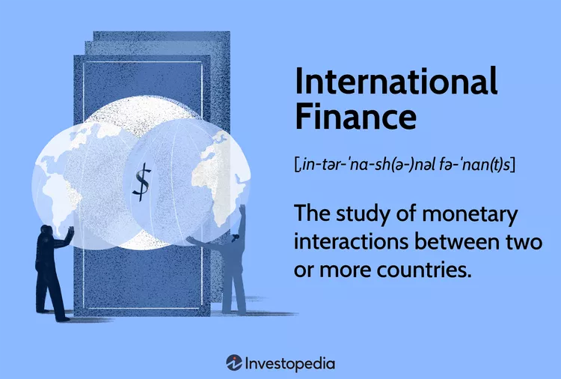
Global/ International Finance
What Is International Finance?
International finance, sometimes known as international macroeconomics, is the study of monetary interactions between two or more countries, focusing on areas such as foreign direct investment and currency exchange rates.

Slide 13
Features of Global Capital Market
Link between Savers and Investment Opportunities
Provides Long Term Investment
Utilizes Intermediaries
Determinate of Capital Formation
Government Rules and Regulations
No Entry Barriers
Absence of Transaction Cost
No Tax Differences
Liquidity
Variety of Instruments

Slide 14
Growth of Global Capital Market
The growth of the global capital market shows strong performance in equity markets and a mixed picture in fixed income and private markets, with a shift in growth towards Asian economies. In 2024, global equity market capitalization increased significantly, while global long-term fixed income issuance saw a slight decrease.
Key Trends in the Global Capital Market
Equity Market Strength: Global equity market capitalization grew substantially in 2024, driven by strong performance in equity issuances.
Fixed Income Performance: While the outstanding global fixed income market grew, long-term fixed income issuance experienced a decrease in the same period.
Rise of Asian Markets: Asian capital markets have been a significant engine of global growth since the early 2000s, with the region accounting for a large portion of the world's listed companies.
Private Markets Adaptation: Global private markets are adjusting to a landscape of structurally higher interest rates. This led to double-digit increases in capital deployment in 2024, even as fundraising reached a multi-year low.
Focus on Innovation: The market is seeing a renewed emphasis on technological investment, client-centric innovations, and integrated solutions to adapt to a changing landscape.

Slide 15
Global equity market
A global equity market refers to the collective trading of stocks (equities) by investors worldwide, with examples including major stock exchanges like the New York Stock Exchange (NYSE) and Nasdaq in the US, the London Stock Exchange (LSE) in the UK, and the Tokyo Stock Exchange in Japan, where companies from different countries are listed and traded by investors globally.
Examples of Major Global Equity Markets:
New York Stock Exchange (NYSE): (United States): One of the largest and most well-known stock exchanges globally, home to many famous companies like IBM and Coca-Cola.
Nasdaq (United States): Another significant US stock exchange known for its technology-focused listings.
London Stock Exchange (LSE): A key exchange in the UK and a major global trading hub.
Tokyo Stock Exchange (JPX): Japan's primary stock exchange and a significant hub for technology and trading in Asia.
Euronext (European Union): A major exchange across several European countries.
Shanghai Stock Exchange (SSE): China's stock exchange and one of the largest in the world.
Hong Kong Stock Exchange (HKEX): An important financial center in Asia for trading global equities.

Slide 16
International Production Management/Global Manufacturing/Production
International production management, also known as global manufacturing, is the strategic and operational management of production and operations across multiple countries to optimize efficiency, cost, and market responsiveness.
Key Considerations:
Local Adaptation: Adapting production technology, internal logistics, and even product designs to suit local market conditions is crucial for fully exploiting global production potential.
Strategic Objectives: Organizations need to design strategic objectives that account for the international business environment, which differs from domestic markets in terms of economic factors and international quality standards.
Location Decisions: Determining the optimal location for production facilities involves considering comparative advantages and other locational determinants, such as labor costs, market demand, and regulatory frameworks.
Technological Trends: New technologies significantly impact international production, influencing supply chain configuration and raising concerns for policymakers.
Cost and Efficiency: Companies aim to achieve higher efficiency and lower costs by strategically allocating production activities across different global locations.

Slide 17
Coordinating Global Manufacturing System
Coordinating a global manufacturing system involves integrating geographically dispersed production facilities, suppliers, and distribution networks worldwide to optimize efficiency, cost, and access to markets
Benefits of Global Manufacturing Coordination
Cost Reduction: Accessing lower labor costs, raw materials, and optimizing overall production costs.
Market Access: Entering new global markets to serve a wider customer base.
Resource Access: Sourcing raw materials and accessing specialized capabilities globally.
Risk Diversification: Spreading manufacturing operations across different regions to mitigate geopolitical or logistical risks.
Challenges in Coordination
Complexity: Managing diverse, dispersed facilities and integrating different systems and processes.
Cultural & Regulatory Differences: Adapting to varied business practices, legal frameworks, and cultural norms across countries.
Quality Management: Maintaining consistent product quality across a global network.
Logistics & Supply Chain Disruptions: Navigating challenges like trade barriers, transportation issues, and global events (e.g., the COVID-19 pandemic).

Slide 18
Thank You

